Slide 1
Uncertain knowledge and reasoning

Slide 2
Outline:
Uncertainty
Representing Knowledge in an Uncertain Domain
Belief Networks
Simple Inference in Belief Network
Bayesian networks
2

Slide 3
Questions:
Explain with example Baye’s Belief network and simple Inference in belief Network.
You have two neighbors, John and Mary, who have promised to call you at work when they hear the alarm. John always calls when he hears the alarm, but sometimes confuses the telephone ringing with the alarm and calls then, too. Marry on the other hand, likes rather loud music and sometimes misses the alarm altogether. Given the evidence of who has or has not called, we would like to estimate the probability of a burglary. Draw a Bayesian network for this domain with suitable tables.
What is Uncertainty? Explain Bayesian network with example.

Slide 4
Uncertainty-
Problems with First-order logic and Logic agent approach-
Agents almost never have access to the whole truth about their environment
So Agent cannot find a categorical answer to some important questions.
The agent therefore act under Uncertainty
For Example, a wumpus agent often will find unable to discover which of two squares contains a pit. If those squares en route to the gold then agent might take a chance and enter one of the two squares.

Slide 5
Uncertain Agent
What we call uncertainty is a summary of all that is not explicitly taken into account in the agent’s KB
Some sentences can be assumed directly from agents percept
?
sensors
?
environment
?
agent
?
actuators
model
Some sentences can be inferred from current and previous percepts together with
knowledge about the properties of the environment

Slide 6
Types of Uncertainty
Uncertainty in prior knowledge E.g., some causes of a disease are unknown and are not represented in the background knowledge of a medical-assistant agent

Slide 7
Types of Uncertainty
For example, to drive my car in the morning:
It must not have been stolen during the night
It must not have flat tires
There must be gas/petrol in the tank
The battery must not be dead
The ignition must work
I must not have lost the car keys
No truck should obstruct the driveway
I must not have suddenly become blind or paralytic
Etc…
Not only would it not be possible to list all of them, but would trying to do so be efficient?
Uncertainty in prior knowledge E.g., some causes of a disease are unknown and are not represented in the background knowledge of a medical-assistant agent
Uncertainty in actions E.g., actions are represented with relatively short lists of preconditions, while these lists are in fact arbitrary long

Slide 8
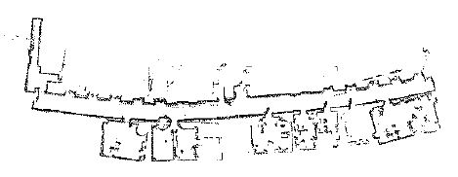
Types of Uncertainty
Uncertainty in prior knowledge E.g., some causes of a disease are unknown and are not represented in the background knowledge of a medical-assistant agent
Uncertainty in actions E.g., actions are represented with relatively short lists of preconditions, while these lists are in fact arbitrary long
Uncertainty in perception E.g., sensors do not return exact or complete information about the world; a robot never knows exactly its position
Courtesy R. Chatila

Slide 9
Types of Uncertainty
Uncertainty in prior knowledge E.g., some causes of a disease are unknown and are not represented in the background knowledge of a medical-assistant agent
Uncertainty in actions E.g., actions are represented with relatively short lists of preconditions, while these lists are in fact arbitrary long
Uncertainty in perception E.g., sensors do not return exact or complete information about the world; a robot never knows exactly its position

Slide 10
Sources of Uncertainty:
Incompleteness and Incorrectness in agents understanding of properties of the environment.
Laziness and Ignorance in storing knowledge as it is inescapable in complex, dynamic or in-accessible world.

Slide 11
Handling Uncertain Knowledge
Consider the example of Diagnosis for medicine, which is a task which involves uncertainty
Dental Diagnosis system using First-order Logic as follows:
∀p symptom(p, Toothache) → disease(p,cavity)
But not all patients have toothache because of cavity some have other problems as-
∀p symptom(p,Toothache) → disease (p,cavity) ∨ disease (p, gum_disease ) ∨ disease (p,Impacted_Wisdom_tooth)…
Hence, to make the rule true, an unlimited list of possible causes must be added.
∀p disease(p,cavity) → symptom (p,Toothache).

Slide 12
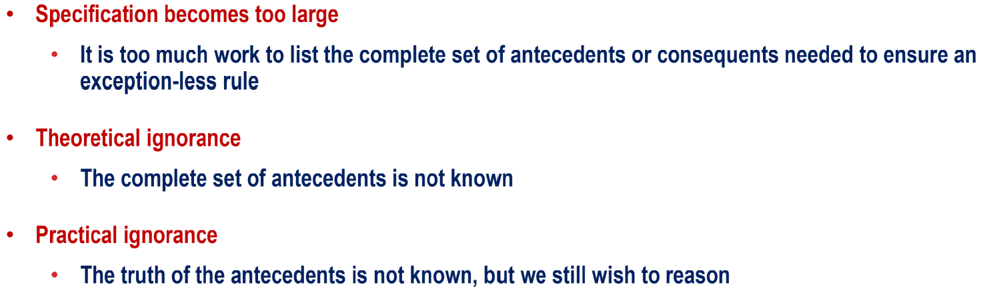
Reasons for using Probability

Slide 13
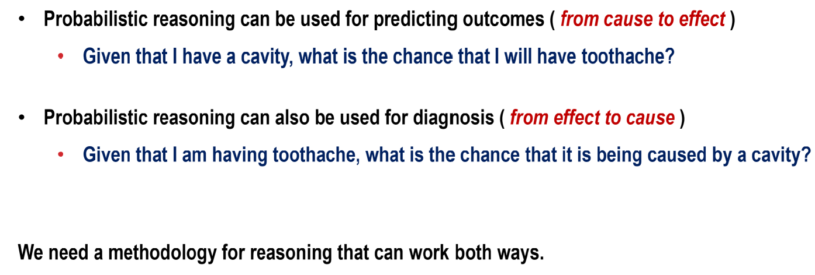
Predicting Vs Diagnosing

Slide 14
Failure of First Order Logic:
FOL fails for 3 main reasons with a domain like medical Diagnosis:
Laziness- to list the complete set of antecedents as it needs too much work.
Theoretical Ignorance- Medical science has no complete theory for the domain.
Practical Ignorance- Even if the rules are known, there may be uncertainty about a particular patient because all the necessary test have not or cannot be run.
Notes:
Antecedents-background, previous history, experience., etc.

Slide 15
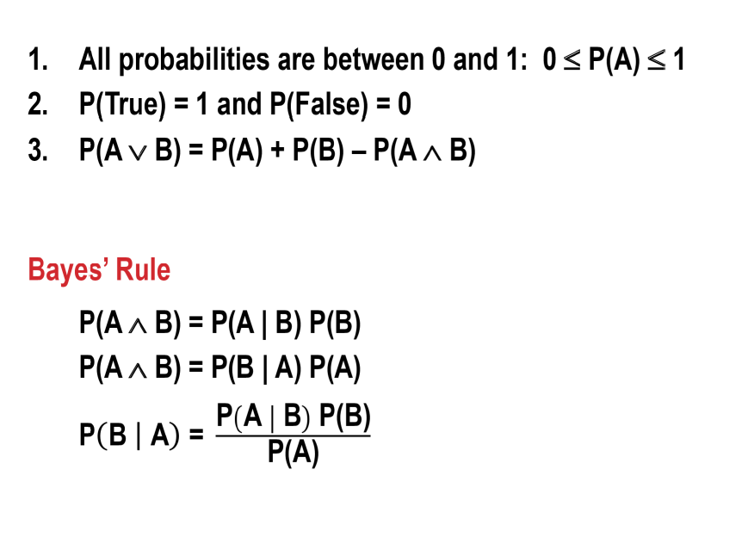
Axioms of Probability

Slide 16
Probability that X is fat = 0.2
If X is fat then X has Coronary Heart Disease (CHD) with prob of = 0.7
P[X has CHD] =

Slide 17
Probability Theory
The agent’s knowledge can at best provide only a degree of belief in the relevant sentences.
Our main tool for dealing with degree of belief will be probability theory.
Probability Theory , which assigns a numerical degree of belief between 0 to 1 to sentences.
Probability provides a way of summarizing the uncertainty that comes from our laziness and ignorance.
For example, we may not know the proper cause but we believe that there is, say, an 80% chance that is, a probability of 0.8- that a patient has a cavity if he or she has a toothache.
From statistical data (80% patient faced the same problem)
General rule
Combination of evidence sources
Rest 20% are patients of other causes.
Probability derived from

Slide 18
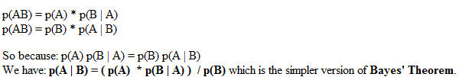
Bayesian Probability- Bayes' Theorem
Product Rule of probability for independent events:
This is actually a special case of the following Product Rule for dependent events, where p(A | B) means the probability of A given that B has already occurred:

Slide 19
Chaining Bayes' Theorem
We may wish to calculate p(AB) given that a third event, I, has happened. This is written p(AB | I). We can use the
Product Rule: P(A,B) = p(A) p(B|A)
p(AB | I) = p(A | I) * p(B | AI)
p(AB | I) = p(B | I) * p(A | BI)
so we have: p(A | BI) = ( p(A | I) * p(B | AI) ) / p(B | I) which is another version of Bayes' Theorem.
This gives us the “probability of A happening given that B and I have happened”.
Note that: p(B) = p(B | A) * p(A) + p(B | ~A) * P(~A)

Slide 20
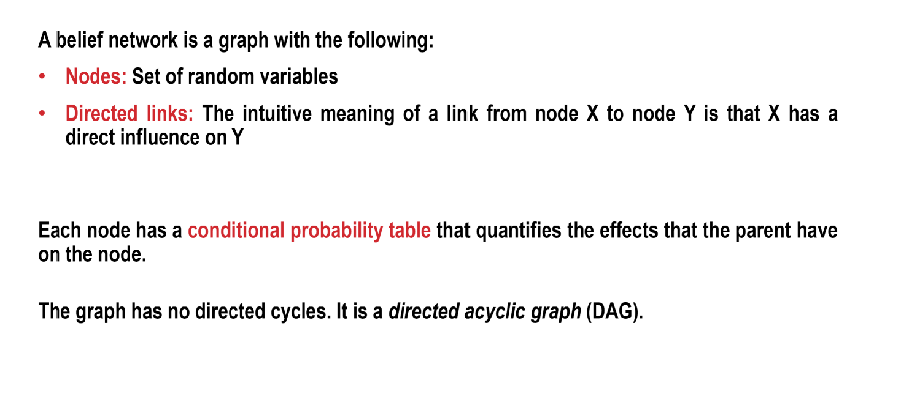
Belief Networks

Slide 21

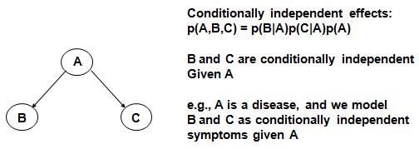
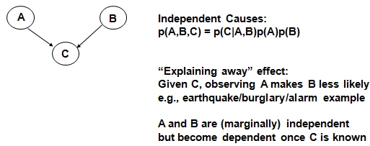
Probabilistic inferences

Slide 22
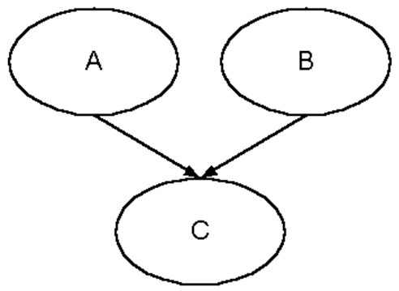
Bayesian Belief Networks
A Bayesian Belief Network (BBN) defines various events, the dependencies between them, and the conditional probabilities involved in those dependencies. A BBN can use this information to calculate the probabilities of various possible causes being the actual
Setting up a BBN
For instance, if event C can be affected by events A and B: cause of an event.

Slide 23
Representing Knowledge in an Uncertain Domain: Bayesian networks
A belief network is a graph in which the following holds:
A set of random variables makes up the nodes of the network.
A set of directed links or arrows connects pairs of nodes. Directed links X→Y: X has a direct influence on Y, X is said to be a parent of Y.
Each node has a conditional probability table that quantifies the effects that the parents have on the node. The parents of a node are all those nodes that have arrows pointing to it.
The graph has no directed cycles.
23

Slide 24


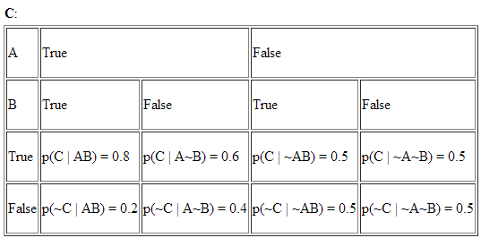
Setting up a BBN:
Probability of each state should be sum to 1

Slide 25
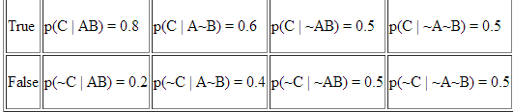
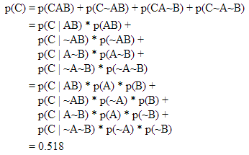
Calculating Initialised probabilities
Using the known probabilities we may calculate the 'initialised' probability of C, by summing the various combinations in which C is true, and breaking those probabilities down into known probabilities:
So as a result of the conditional probabilities, C has a 0.518 chance of being true in the absence of any other evidence.
P(A)= 0.1
P(~A)= 0.9
P(B)= 0.4
P(~B)= 0.6

Slide 26
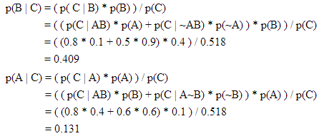
Calculating Revised probabilities: Simple Inference
If we know that C is true, we can calculate the 'revised' probabilities of A or B being true (and therefore the chances that they caused C to be true), by using Baye’s Theorem with the initialised probability:
So we could say that given C is true, B is more likely to be the cause than A.

Slide 27
The earthquake example
Burglar alarm at Home
Fairly reliable at detecting a burglary
Responds at times to minor earthquakes
Two neighbors, on hearing alarm, calls Police
John always calls when he hears the alarm, but sometimes confuses the telephone ringing with the alarm and calls then, too.
Mary likes loud music and sometimes misses the alarm altogether

Slide 28
The earthquake example
You have a new burglar alarm installed
It is reliable about detecting burglary, but responds to minor earthquakes
Two neighbors (John, Mary) promise to call you at work when they hear the alarm
John always calls when hears alarm, but confuses alarm with phone ringing (and calls then also)
Mary likes loud music and sometimes misses alarm!
Given evidence about who has and hasn’t called, estimate the probability of a burglary.

Slide 29
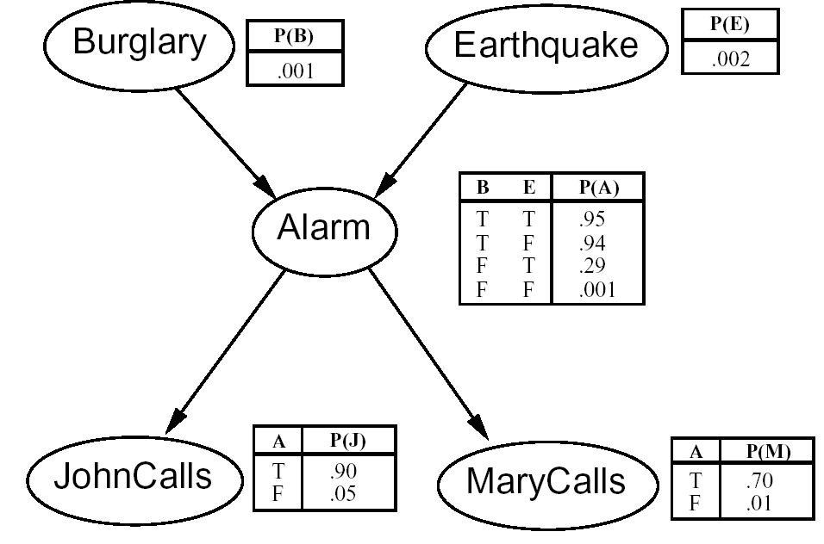
The Belief Network
I´m at work, John calls to say my alarm is ringing, Mary doesn´t call. Is there a burglary?
5 Variables network topol-ogy reflects causal knowledge
A typical belief network with conditional probabilities. All variables(nodes) are Boolean, So the probability of say- P(A) in any row of its table is 1- P(A)

Slide 30
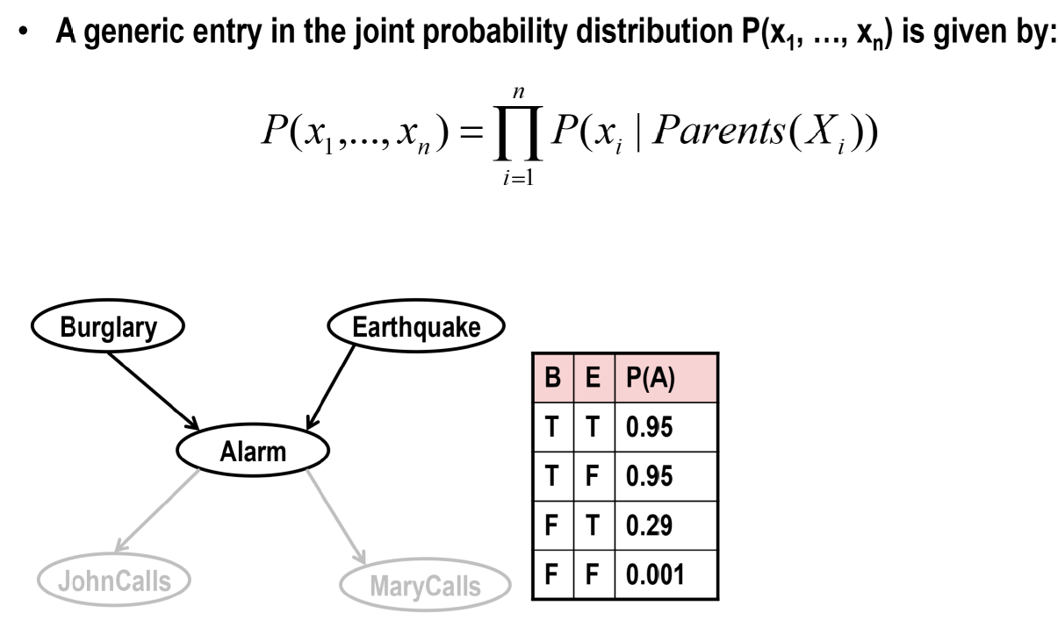
Joint Probability Distribution

Slide 31
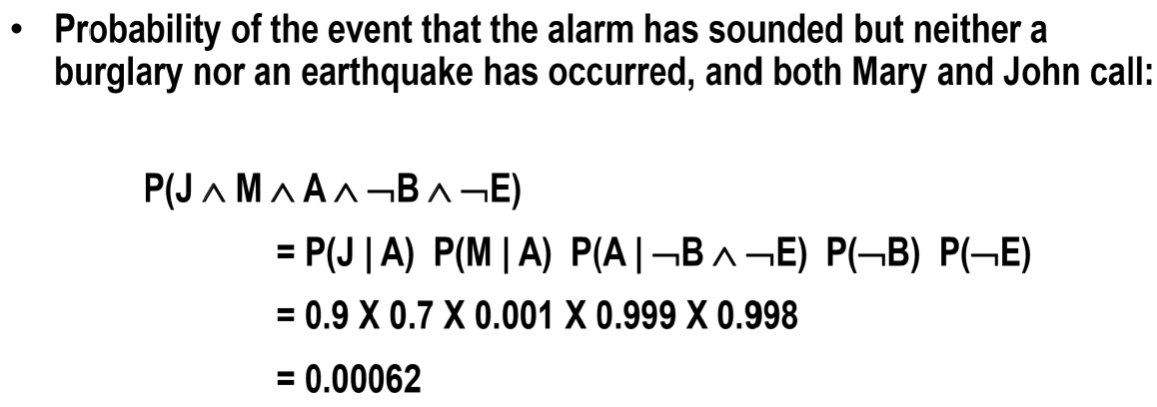
Joint Probability Distribution

Slide 32
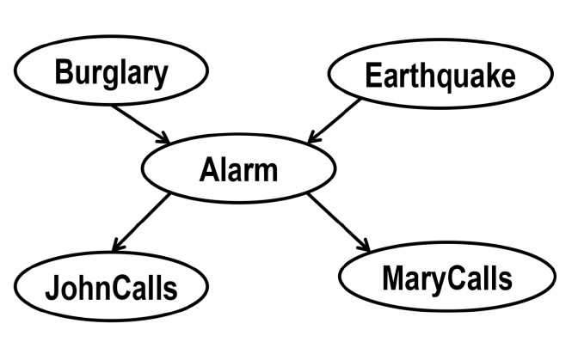
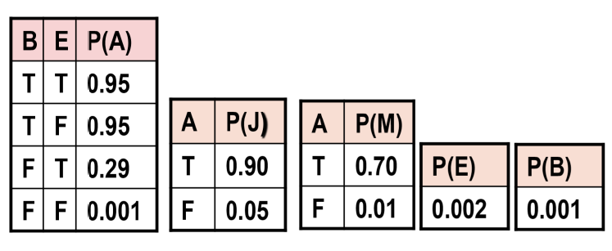
Joint Probability Distribution

Slide 33
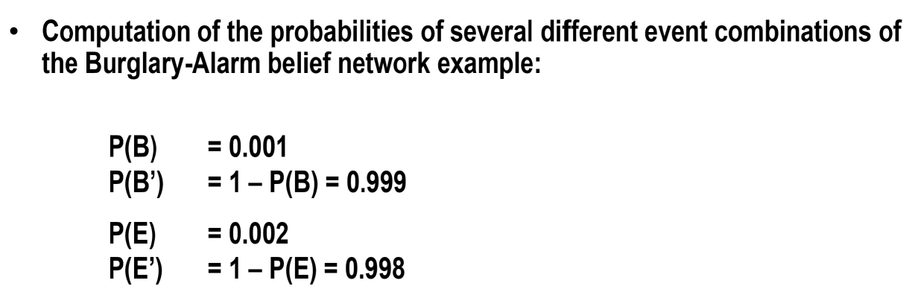
Joint Probability Distribution

Slide 34
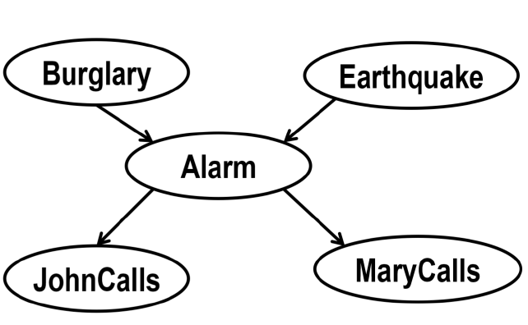
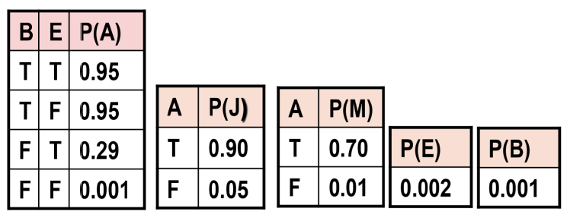
Joint Probability Distribution

Slide 35
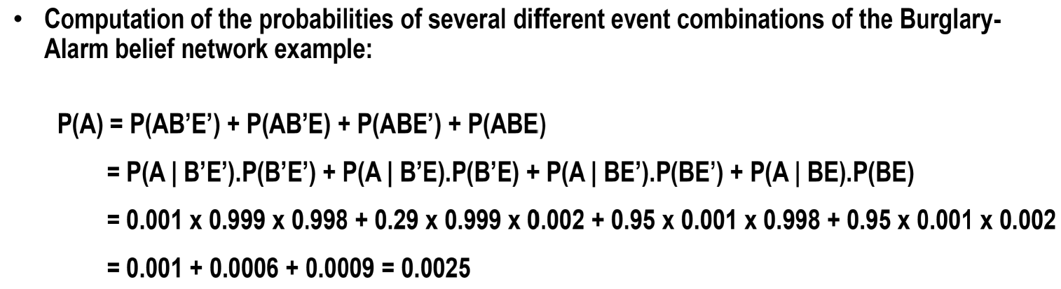
Joint Probability Distribution

Slide 36
Joint Probability Distribution

Slide 37
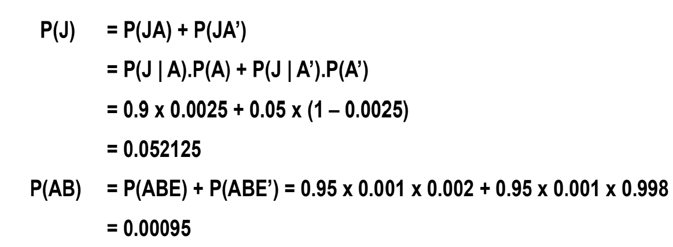
Joint Probability Distribution

Slide 38
Joint Probability Distribution

Slide 39
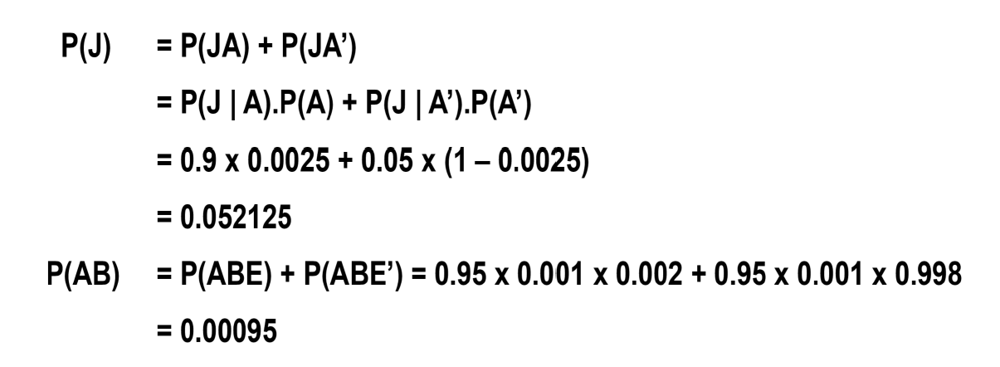
Joint Probability Distribution: Find P(J)

Slide 40
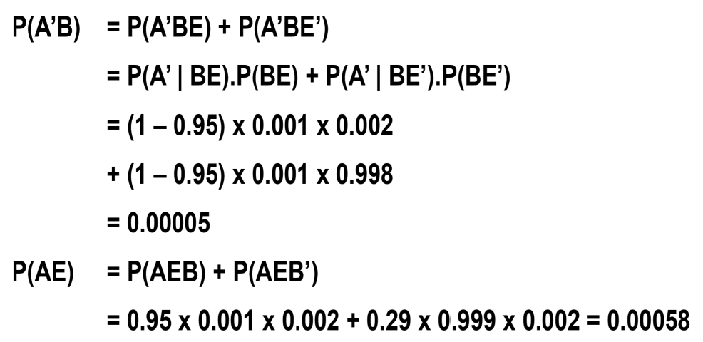
Joint Probability Distribution: Find P(A’B) and P(AE)

Slide 41
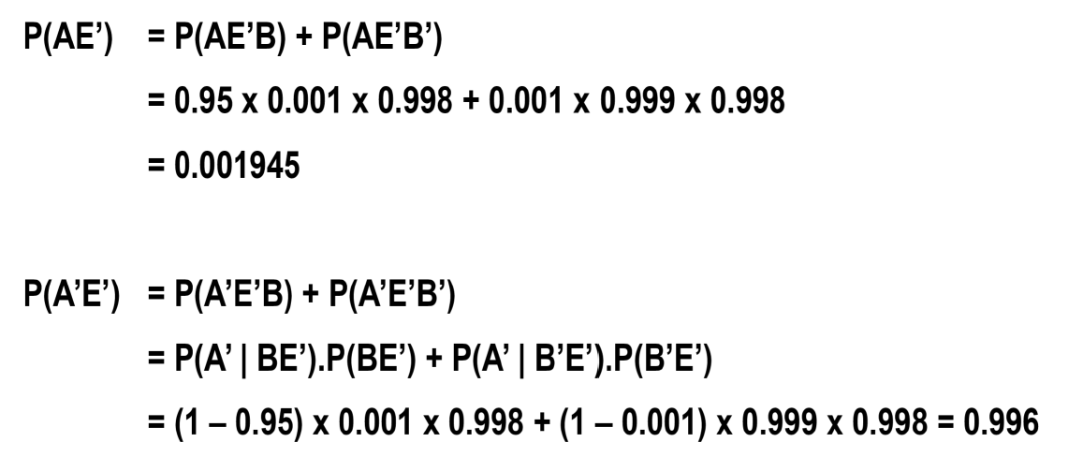
Joint Probability Distribution:

Slide 42
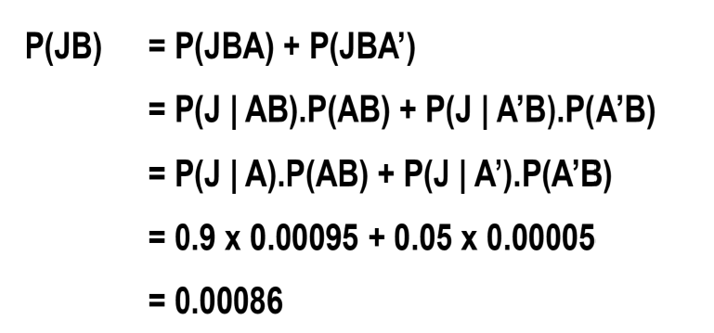
Joint Probability Distribution: Find P(JB)

Slide 43
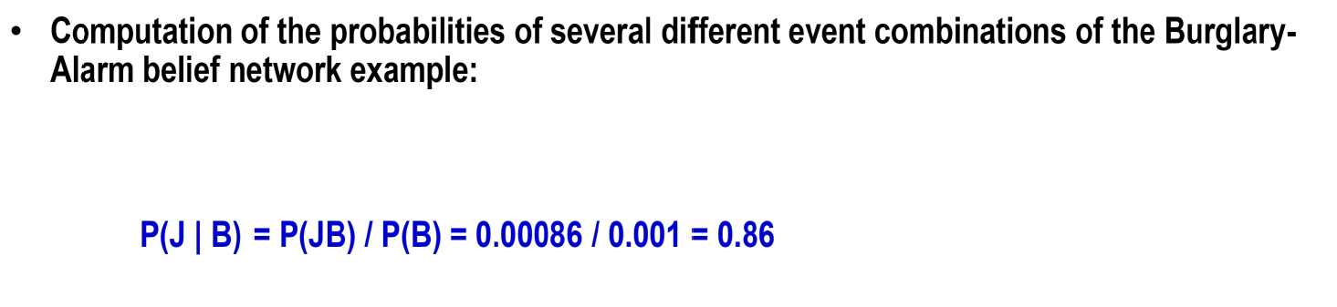
Joint Probability Distribution:

Slide 44
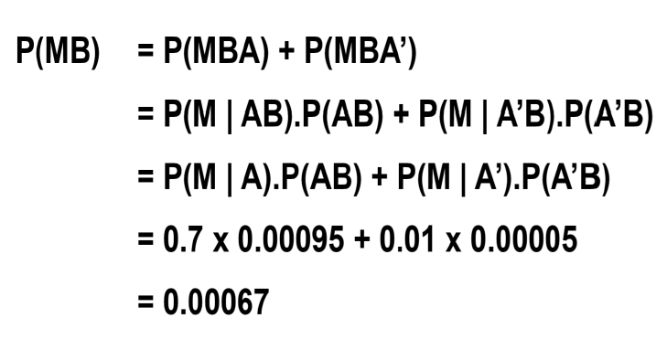
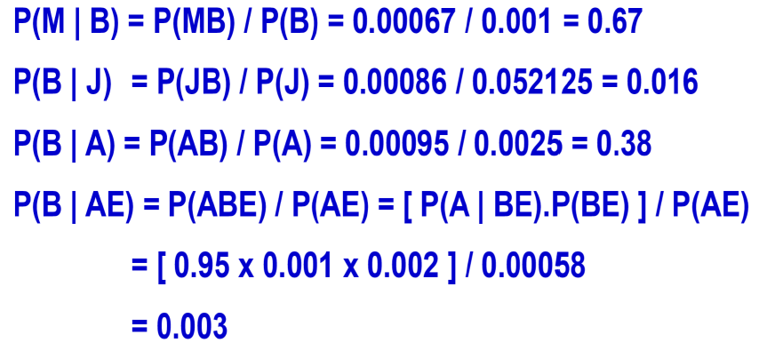
Joint Probability Distribution:

Slide 45
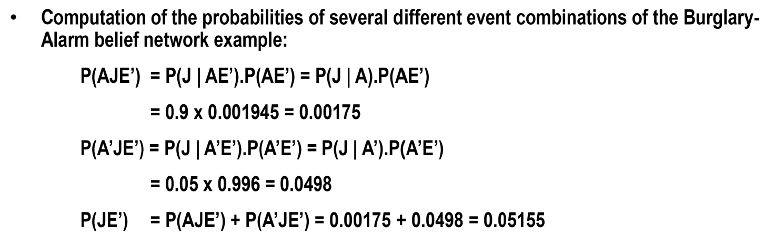
Joint Probability Distribution:

Slide 46
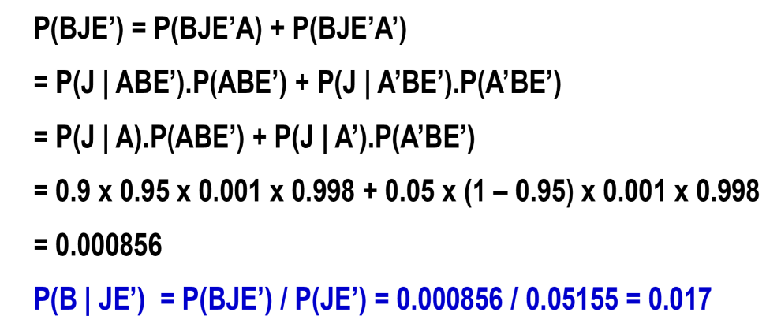
Joint Probability Distribution:

Slide 47
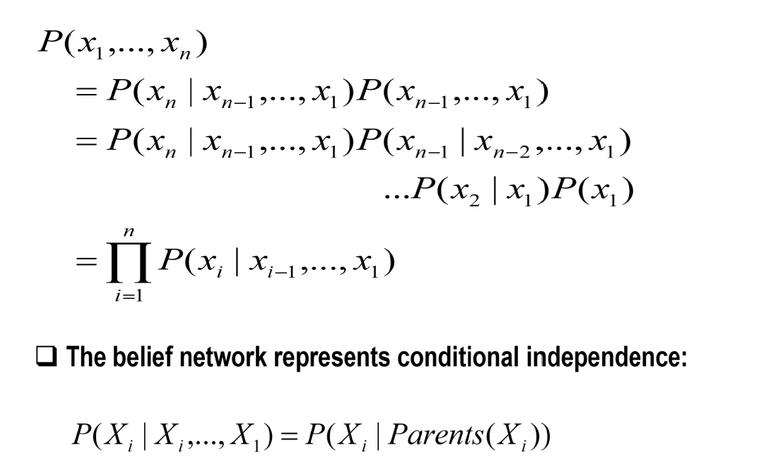
Conditional Independence
The key feature of the belief network

Slide 48
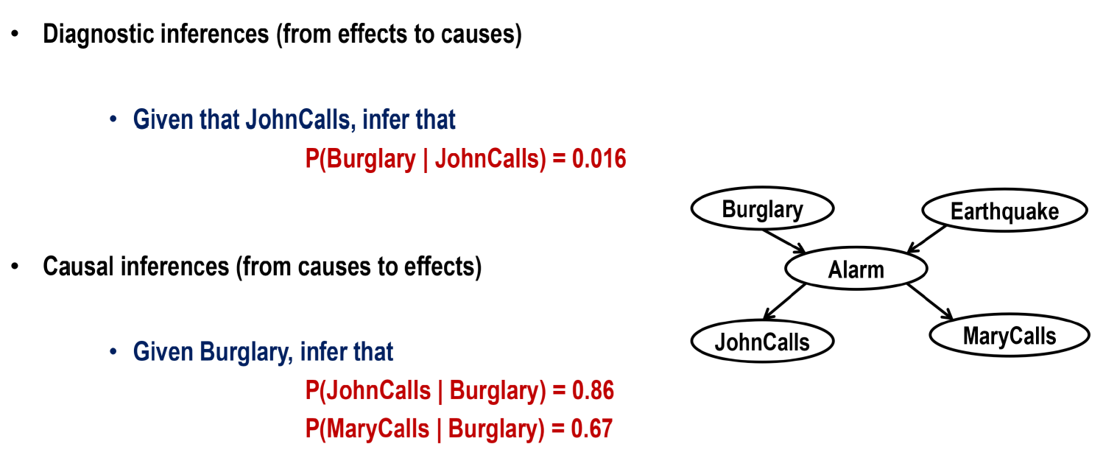
Inferences using belief networks

Slide 49
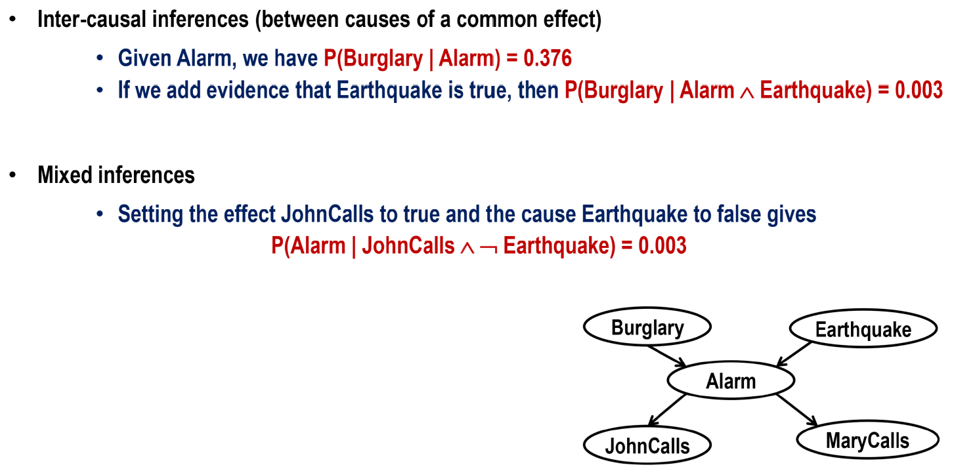
Inferences using belief networks

Slide 50
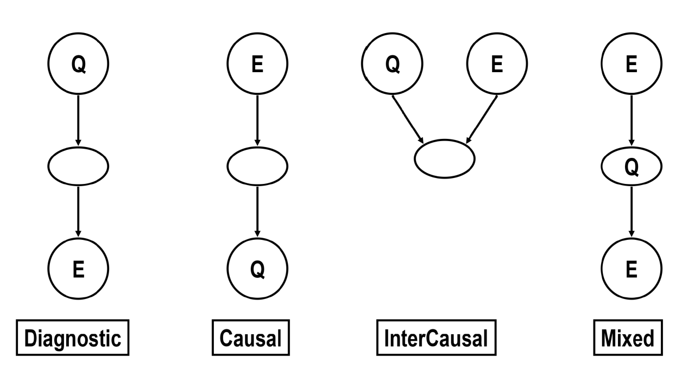
Four Patterns

Slide 51
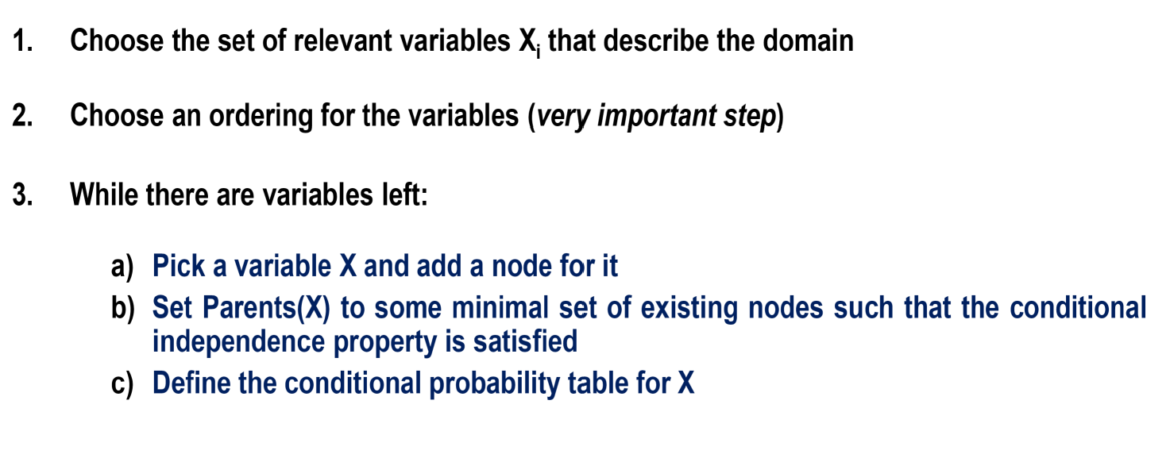
Incremental Network Construction

Slide 52
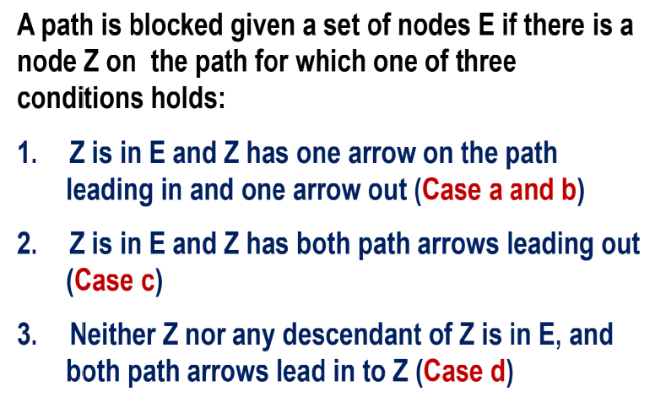
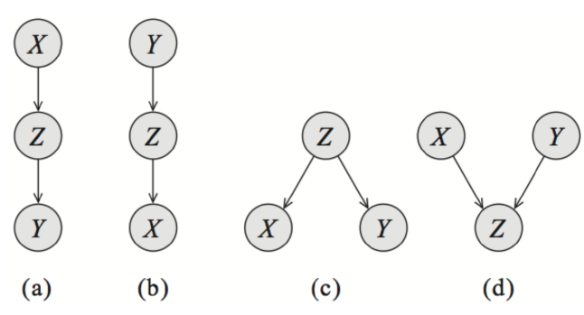
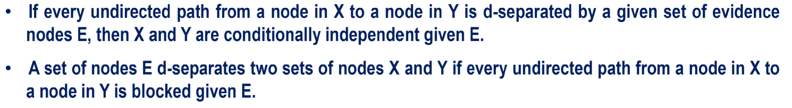
Conditional Independence Relations

Slide 53
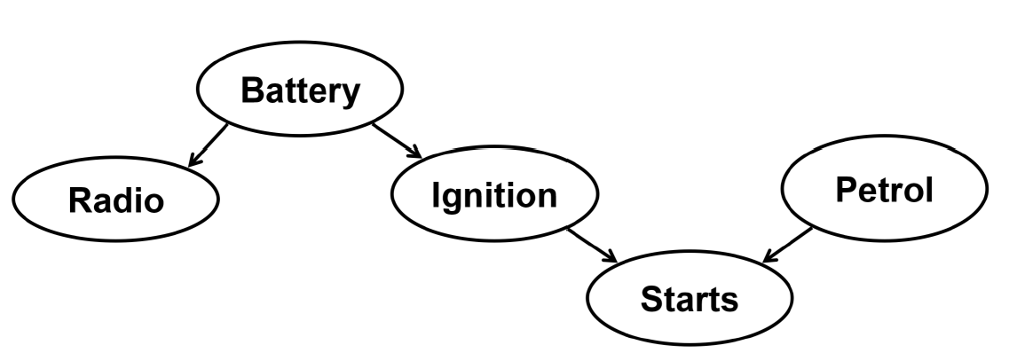
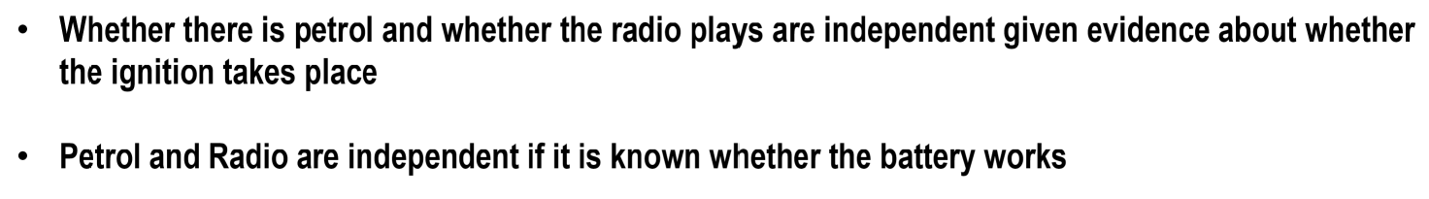
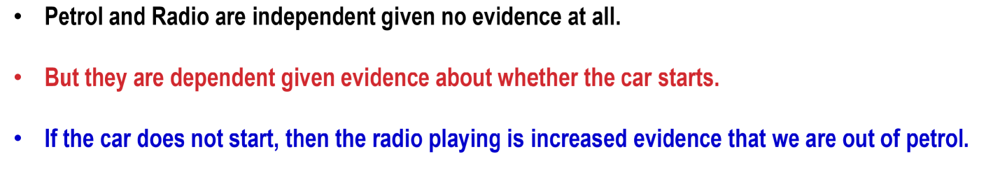
Conditional Independence Relations

Slide 54
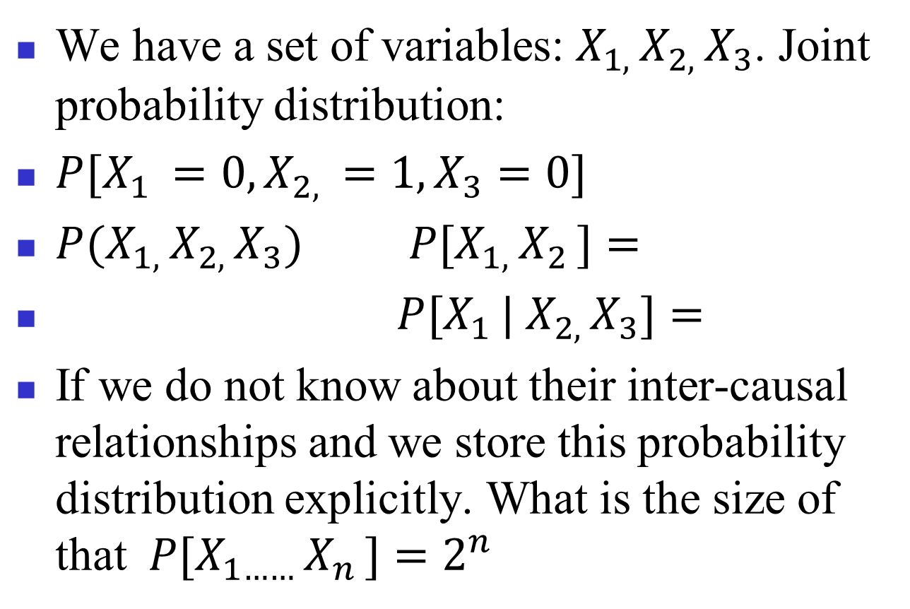
Understanding BN
We have a set of variables: $X_{1, }X_{2, }X_{3}$. Joint probability distribution:
${P[X}_{1 }=0, X_{2, }=1, X_{3}=0]$
${P(X}_{1, }X_{2, }X_{3})$ ${P[X}_{1, }X_{2 }]=$
${P[X}_{1 }| X_{2, }X_{3}]=$
If we do not know about their inter-causal relationships and we store this probability distribution explicitly. What is the size of that${ P[X}_{1…… }X_{n }]=2^{n}$

Slide 55
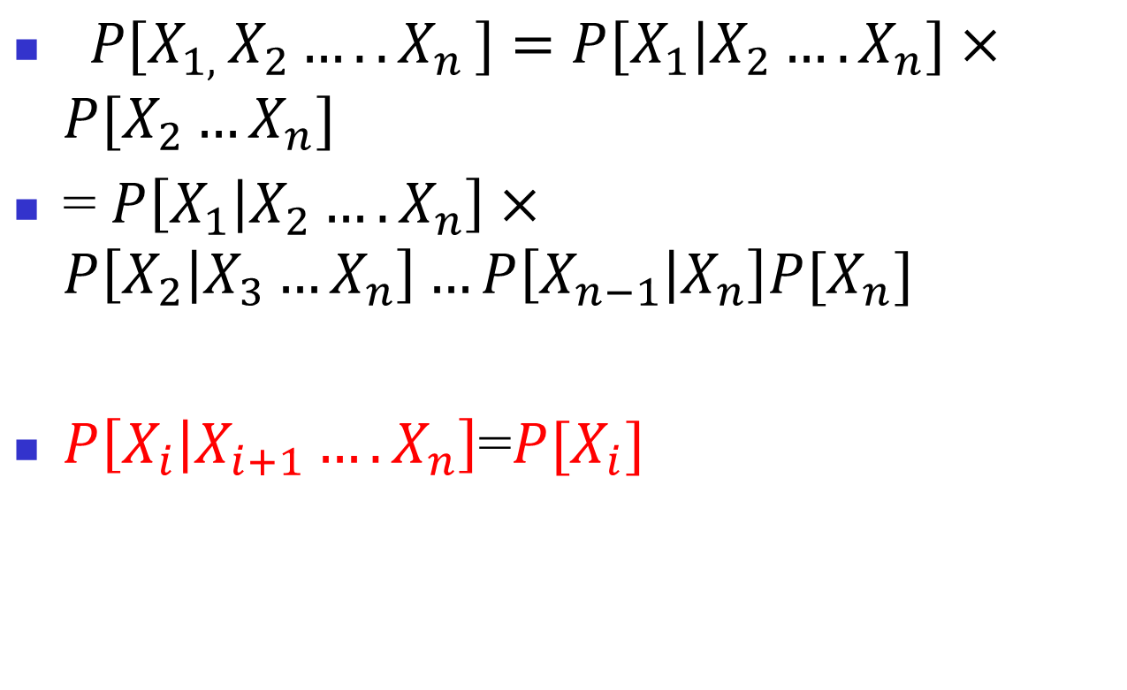
Understanding BN: Rewrite Joint Probability Distribution
${ P[X}_{1, }X_{2}…..X_{n }]=P[X_{1}|X_{2}….X_{n}]×P[X_{2}…X_{n}]$
= $P\left[X_{1} | X_{2}….X_{n}\right]×P\left[X_{2} | X_{3}…X_{n}\right]…P\left[X_{n−1} | X_{n}\right]P[X_{n}]$
$P\left[X_{i} | X_{i+1}….X_{n}\right]$=$P[X_{i}]$

Slide 56
Understanding BN: Rewrite Joint Probability Distribution
P[JohnCalls | Alarm, Burglary] = P[JohnCalls | Alarm]

Slide 57
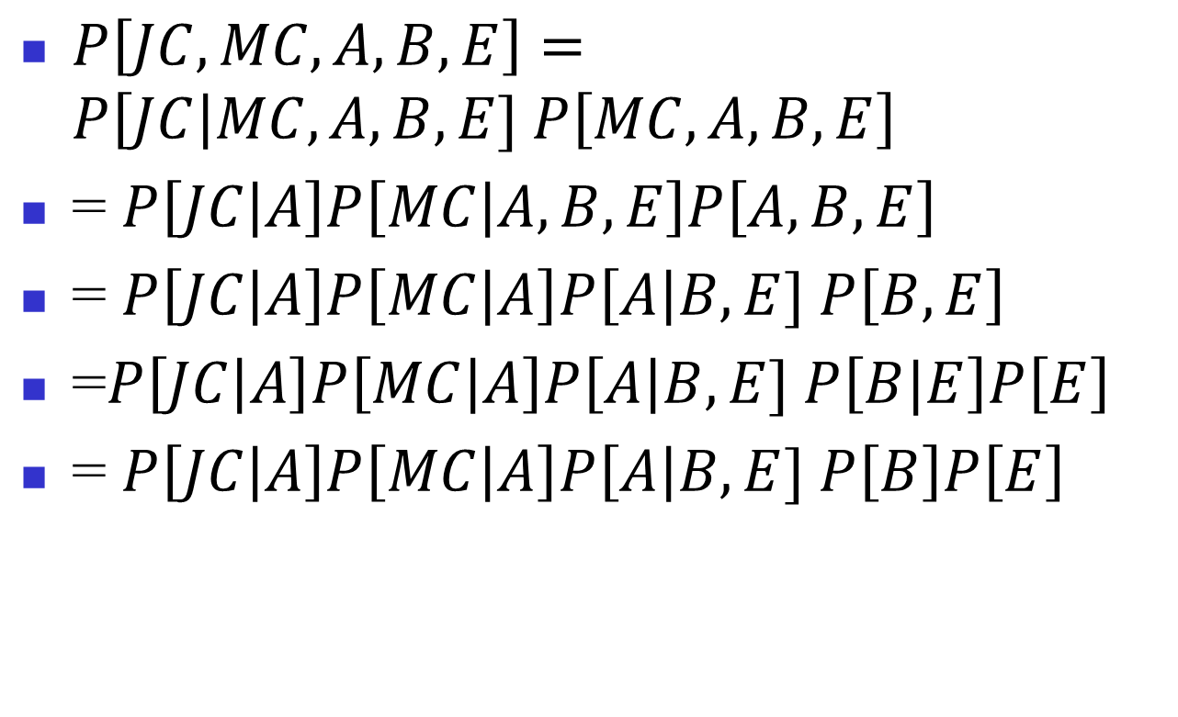
Ordering
$P\left[JC, MC, A, B, E\right]=P\left[JC\right|MC, A, B, E] P\left[MC, A, B, E\right]$
= $P\left[JC | A\right]P\left[MC | A, B, E\right]P\left[A, B, E\right]$
= $P\left[JC | A\right]P\left[MC | A\right]P\left[A\right|B, E] P\left[B, E\right]$
=$P\left[JC | A\right]P\left[MC | A\right]P\left[A\right|B, E] P\left[B|E\right]P\left[E\right]$
= $P\left[JC | A\right]P\left[MC | A\right]P\left[A\right|B, E] P\left[B\right]P\left[E\right]$

Slide 58
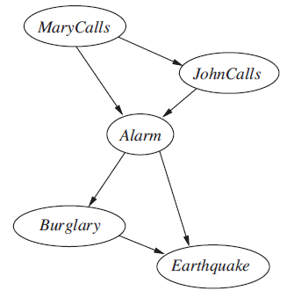
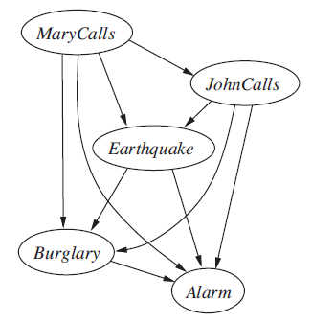
Compactness and node ordering

Slide 59




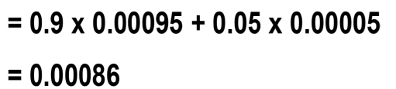
Computations
= 0.9 X P(AB) + 0.05 X A(A’B)

Slide 60



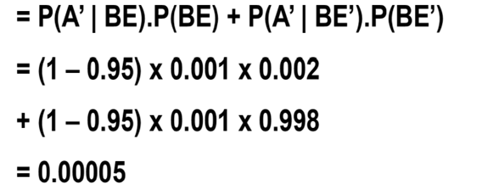
Computations
= P(A|BE) X P(BE) + P(A|BE’) X P(BE’)

Slide 61






Computations
P(A’) = 1-0.0025

Slide 62
Answering Queries
We consider cases where the belief network is a poly-tree.
There is at most one undirected path between any two nodes.

Slide 63

Constructing this Bayesian Network:

Slide 64
Bayesian network - example
P(B)
0.001
P(~B)
0.999
Burglary
P(E)
0.002
Earthquake
P(~E)
0.998
B E P(A)
T T 0.95
T F 0.94
F T 0.29
F F 0.001
Alarm
A P(J)
T 0.9
F 0.05
A P(M)
T 0.7
F 0.01
JohnCalls
MaryCalls
B E P(A | B, E)
T F
T T 0.95 0.05
T F 0.94 0.06
F T 0.29 0.71
F F 0.001 0.999
Each row in conditional probability table must sum to 1, because the entries represent an exhaustive set of cases for the variable.
Conditional probability
table
64

Slide 65

Probabilistic inferences
Probability of the event that the alarm has sounded but neither a burglary nor an Earthquake has occurred, and both John and Mary call can be calculated as follows:
P(J ∧ M ∧ A ∧∼B ∧∼E ) = P(J|A)* P(M|A)*P(A|∼B ∧∼E )*P(∼B) ∧P(∼E)=0.9 * 0.7 * 0.001 * 0.999 * 0.998 = 0.00062
65

Slide 66
Probabilistic inferences
Probability of Burglary being true if Alarm is true:
P(A|B) = P(A|B,E) *P(E|B) + P(A| B,∼E)*P(∼E|B)
= P(A|B,E) *P(E) + P(A| B,∼E)*P(∼E)
= 0.95 * 0.002 + 0.94 * 0.998 = 0.94002
66

Slide 67
Thank you

Slide 68
More slides for inference

Slide 69
More Examples on Inferences
Probability distribution P(Cavity, Tooth)
Tooth ∼ Tooth
Cavity 0.04 0.06
∼ Cavity 0.01 0.89
P(Cavity) = 0.04 + 0.06 = 0.1
P(Cavity ∨ Tooth) = 0.04 + 0.01 + 0.06 = 0.11
P(Cavity | Tooth) = P(Cavity ∧ Tooth) / P(Tooth) = 0.04 / 0.05
69

Slide 70
Inferences
 | Tooth |  | ~ Tooth
 | Catch | ~ Catch | Catch | ~ Catch
Cavity | 0.108 | 0.012 | 0.072 | 0.008
~ Cavity | 0.016 | 0.064 | 0.144 | 0.576
Probability distributions P(Cavity, Tooth, Catch)
P(Cavity) = 0.108 + 0.012 + 0.72 + 0.008 = 0.2
P(Cavity ∨ Tooth) = 0.108 + 0.012 + 0.072 + 0.008 + 0.016
+ 0.064 = 0.28
P(Cavity | Tooth) = P(Cavity ∧ Tooth) / P(Tooth) =
[P(Cavity ∧ Tooth ∧ Catch) + P(Cavity ∧ Tooth ∧ ~ Catch)] * / P(Tooth)
70

